Slide 1
Interfacing an LCD to the 8051 Microcontroller:
Engr.Shahzada Fahim Jan

Slide 2
LCDs are economical
easily programmable
have no limitation of displaying special & even custom characters (unlike in seven segments), animations, and so on.
A 16×2 LCD means it can display 16 characters per line and there are 2 such lines
In this LCD each character is displayed in a 5×7 pixel matrix.
This LCD has two registers, namely, Command and Data.

Slide 3
The command register stores the command instructions given to the LCD.
A command is an instruction given to LCD to do a predefined task like initializing it, clearing its screen, setting the cursor position, controlling the display, etc.
The data register stores the data to be displayed on the LCD. The data is the ASCII value of the character to be displayed on the LCD.

Slide 4
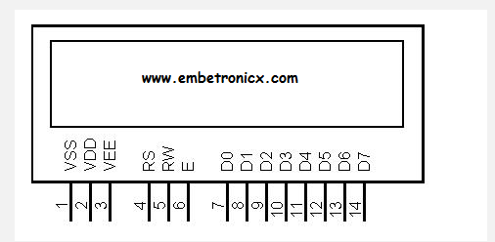

Slide 5
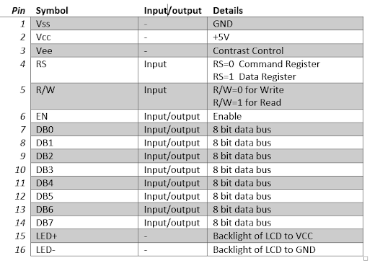

Slide 6
2) RS (Register Select):
The RS pin is used to select command code register or data register. If RS=0 the command code register is selected which allows us to send the instructions to LCD. If RS=1 the data register is selected which allows us to send data to be displayed on LCD.
3) RW(Read/Write):
R/W input allows the user to write information to the LCD or read info from it.
R/W =1 when reading
R/W =0 when writing
4) EN (Enable):
when data or command is sent to LCD a high-to-low pulse must applied to the PIN. So Enable pin is toggled by sending first 1 and then 0.

Slide 7
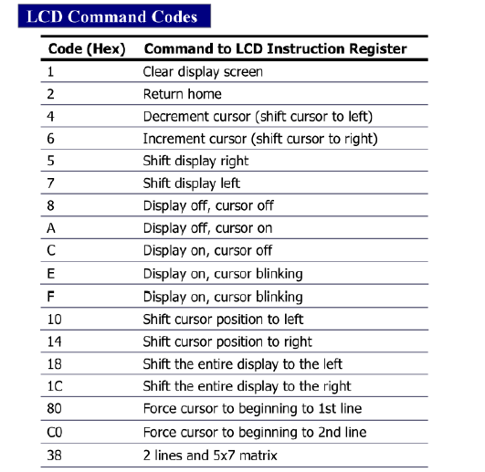

Slide 8
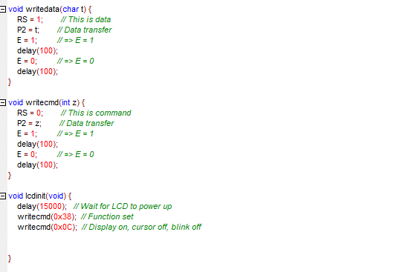

Slide 9
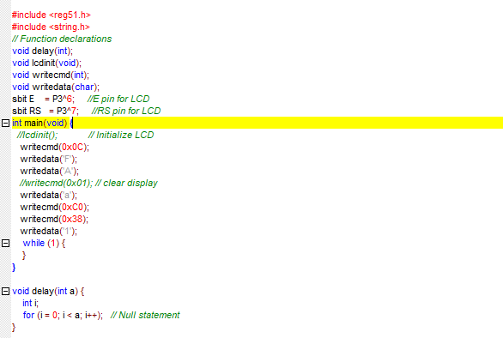

Slide 10
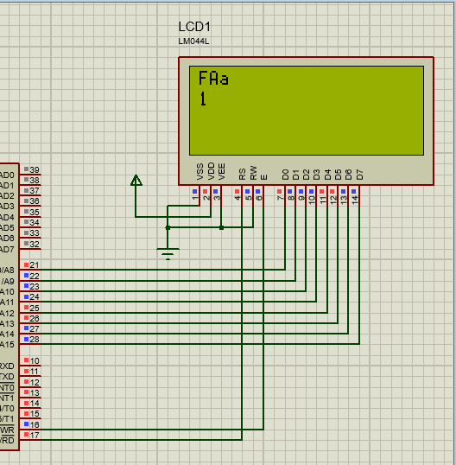

Slide 11
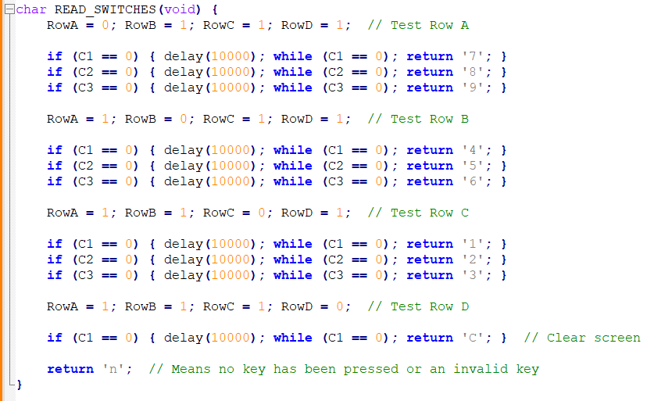
Reading Key

Slide 12
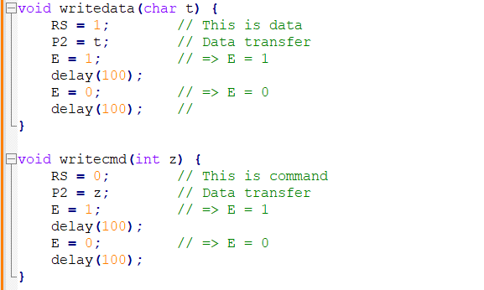

Slide 13
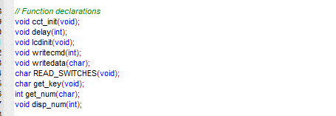
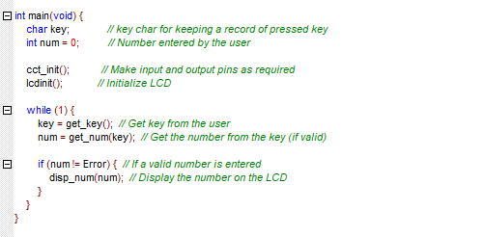

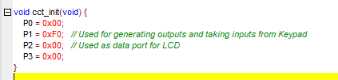

Slide 14
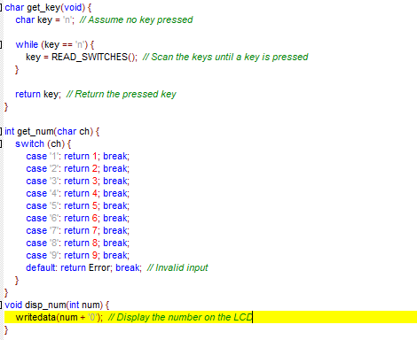
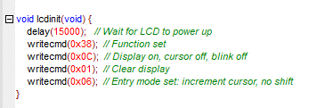

Slide 15
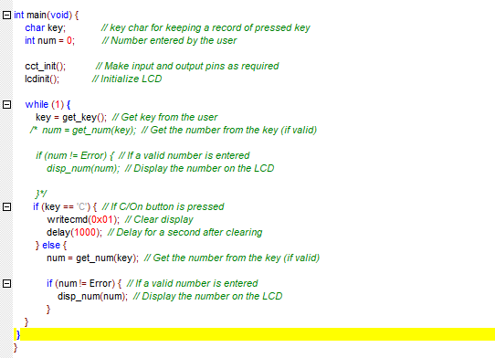
Clear display if C/On key is pressed

Slide 16
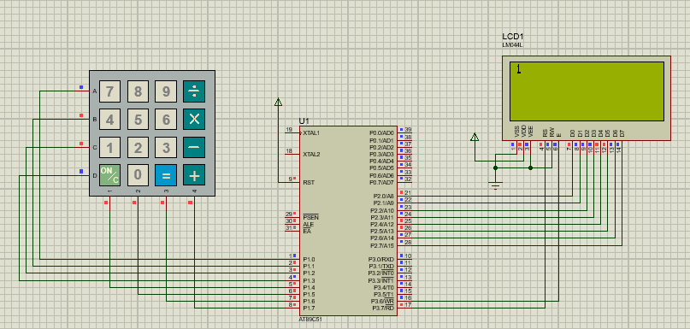

Slide 17
TASKS:
1) Write Your Name on First Line and registration Number on second line of LCD.
2) Input numbers from keypad from 1 to 9 and display on the LCD
3) Make a calculator using keypad and LCD which perform (+,-,*,/)
6 + 6 = 12
6 * 6 = 36
6 / 6 = 1
6 - 3 = 3

